Slide 1
what is a 360 video booth
https://sites.google.com/view/360photoboothrentalmalibu/home
Notes:
https://drive.google.com/drive/folders/1LuDTqxKkMH9nX-0_wIvFUxoCZJGftF2I?usp=sharing
https://docs.google.com/document/d/1ZRMKUZ7_74-ZbMVzujIos8oVJBHV0DDBv9McTVMMHTs/edit?usp=sharing
https://docs.google.com/document/d/1ZRMKUZ7_74-ZbMVzujIos8oVJBHV0DDBv9McTVMMHTs/pub
https://docs.google.com/document/d/1ZRMKUZ7_74-ZbMVzujIos8oVJBHV0DDBv9McTVMMHTs/view
https://docs.google.com/presentation/d/1GdMkcIuq3MNuFaFkSuLp9vZpVP3rm1QxMPTCm5f4nFg/edit?usp=sharing
https://docs.google.com/presentation/d/1GdMkcIuq3MNuFaFkSuLp9vZpVP3rm1QxMPTCm5f4nFg/pub
https://docs.google.com/presentation/d/1GdMkcIuq3MNuFaFkSuLp9vZpVP3rm1QxMPTCm5f4nFg/view
https://docs.google.com/document/d/1xBl2cu3aw6djX5bmM2kUXXwA6_yokVuAlUbdwcpf7sU/edit?usp=sharing
https://docs.google.com/document/d/1xBl2cu3aw6djX5bmM2kUXXwA6_yokVuAlUbdwcpf7sU/pub
https://docs.google.com/document/d/1xBl2cu3aw6djX5bmM2kUXXwA6_yokVuAlUbdwcpf7sU/view
https://docs.google.com/presentation/d/1u01K0CWmIYRAC5nHs-FJF7O4hIV1gTHRO3vJQsJn9Ow/edit?usp=sharing
https://docs.google.com/presentation/d/1u01K0CWmIYRAC5nHs-FJF7O4hIV1gTHRO3vJQsJn9Ow/pub
https://docs.google.com/presentation/d/1u01K0CWmIYRAC5nHs-FJF7O4hIV1gTHRO3vJQsJn9Ow/view

Slide 2
what is a 360 video booth
Like other Lucky Frog photo booth experiences, the 360 Photo Booth can accommodate up to 4 event guests, and is a great group activity! Depending on the size of the person, our sturdy 360-degree video booth platform can accommodate around 4 people at a time. Considering the viral content you can produce with 360 Video Booth, it is perfect for any special event or gala around Alhambra and Arcadia, Artesia, Beverly Hills, Burbank, Carson, Culver City, Glendale, Hermosa Beach, Manhattan Beach, Monterey Park, Palos Verdes, Pasadena, and the Santa Monica Coastal area along with Aliso Viejo, Anaheim, Brea, and Buena Park, as well as all of Orange County. Creating sharable content has become a very important descision making factor when renting a photo booth. In our social media dominated society that values influencers and online celebrities, a 360-degree photo booth lets you share your HD videos instantly on several different platforms, and we can create vertical content for TikTok or Instagram stories or Horizontal videos for Facebook and Youtube. Our 360-degree experience is perfect for instant gratification at your corporate events, social events, and is also perfect for social media influencers who want to increase engagement with their followers. All photo booth experiences, including a 360 photo booth rental are social media powerhouses. From the moment you and your event guests enter our 360 photo booth platform, it's just a matter of seconds until it's transferred to your device. a 360 photo booth rental allows you to share your video creation via your social media, and is transferred via airdrop or QR code scanning. From the seond someone steps onto the spinner to when they get their video airdropped the whole 360 video creation process leads to sharing on social media platforms like TikTok, Instagram, or Twitter.
https://sites.google.com/view/360photoboothrentalmalibu/home
Notes:
360 video booth automatic,what is a 360 video booth,360 video booth business,360 video booth cost,360 degree photo booth video,360 experience video booth,360 video booth for rent,360 grad video booth,360 video booth hire,360 video booth with ring light,orcavue life 360 video booth,360 video booth near me,revolve 360 video booth near me,360 slow motion video booth,orcavue 360 video booth,orcavue xl 360 video booth,360 video booth platform,360 video booth platform spinner

Slide 3
Contact Information
Lucky Frog Photo Booth | 360 Video Booth Rental Los Angeles
532 S Olive St, Los Angeles, CA 90013
(562) 303-9926
Notes:
Lucky Frog Photo Booth | 360 Video Booth Rental Los Angeles532 S Olive St, Los Angeles, CA 90013(562) 303-9926

Slide 4
More info about us:
360 video booth automatic
what is a 360 video booth
360 video booth business
360 video booth cost
360 degree photo booth video
360 experience video booth
360 video booth for rent
360 grad video booth
360 video booth hire
360 video booth with ring light
orcavue life 360 video booth
360 video booth near me
revolve 360 video booth near me
360 slow motion video booth
orcavue 360 video booth
orcavue xl 360 video booth
360 video booth platform
360 video booth platform spinner
Notes:
Lucky Frog Photo Booth | 360 Video Booth Rental Los Angeles532 S Olive St, Los Angeles, CA 90013(562) 303-9926

Slide 5
Links
List of recommended resources
Notes:
360 video booth automatic,what is a 360 video booth,360 video booth business,360 video booth cost,360 degree photo booth video,360 experience video booth,360 video booth for rent,360 grad video booth,360 video booth hire,360 video booth with ring light,orcavue life 360 video booth,360 video booth near me,revolve 360 video booth near me,360 slow motion video booth,orcavue 360 video booth,orcavue xl 360 video booth,360 video booth platform,360 video booth platform spinner

Slide 6
Please visit :
folder Microsoft Files
document
document pub
document view
presentation
presentation pub
presentation view
document
document pub
document view
presentation
presentation pub
presentation view

Slide 7
Videos
YouTube videos we recommend watching!
Notes:
360 video booth automatic,what is a 360 video booth,360 video booth business,360 video booth cost,360 degree photo booth video,360 experience video booth,360 video booth for rent,360 grad video booth,360 video booth hire,360 video booth with ring light,orcavue life 360 video booth,360 video booth near me,revolve 360 video booth near me,360 slow motion video booth,orcavue 360 video booth,orcavue xl 360 video booth,360 video booth platform,360 video booth platform spinner

Slide 8
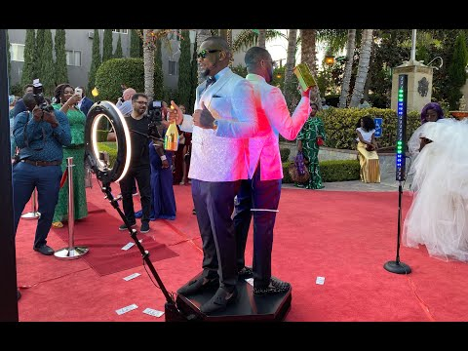
https://sites.google.com/view/360photoboothrentalmalibu/home

Slide 9
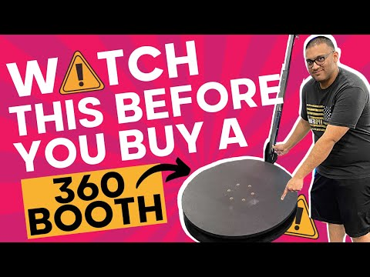
https://sites.google.com/view/360photoboothrentalmalibu/home

Slide 10
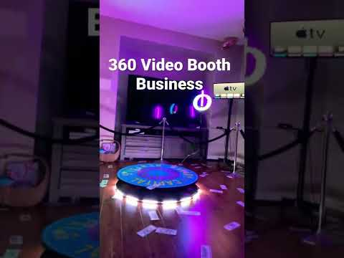
https://sites.google.com/view/360photoboothrentalmalibu/home

Slide 11
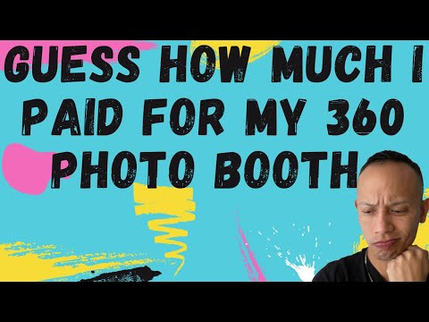
https://sites.google.com/view/360photoboothrentalmalibu/home

Slide 12
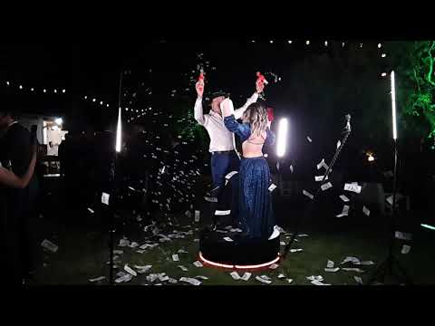
https://sites.google.com/view/360photoboothrentalmalibu/home

Slide 13
https://sites.google.com/view/360photoboothrentalmalibu/home

Slide 14
https://sites.google.com/view/360photoboothrentalmalibu/home

Slide 15
https://sites.google.com/view/360photoboothrentalmalibu/home

Slide 16
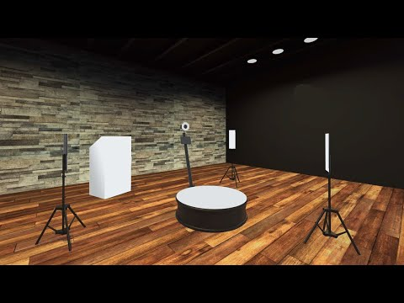
https://sites.google.com/view/360photoboothrentalmalibu/home

Slide 17
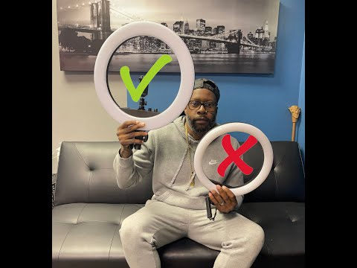
https://sites.google.com/view/360photoboothrentalmalibu/home

Slide 18
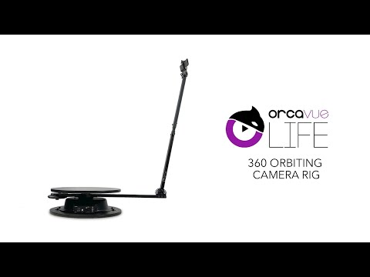
https://sites.google.com/view/360photoboothrentalmalibu/home

Slide 19
https://sites.google.com/view/360photoboothrentalmalibu/home

Slide 20
https://sites.google.com/view/360photoboothrentalmalibu/home

Slide 21
https://sites.google.com/view/360photoboothrentalmalibu/home

Slide 22
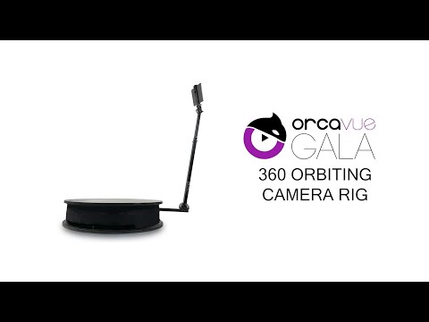
https://sites.google.com/view/360photoboothrentalmalibu/home

Slide 23
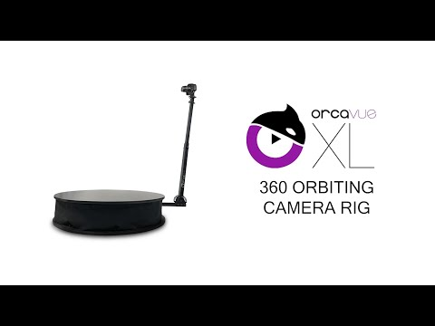
https://sites.google.com/view/360photoboothrentalmalibu/home

Slide 24
https://sites.google.com/view/360photoboothrentalmalibu/home

Slide 25
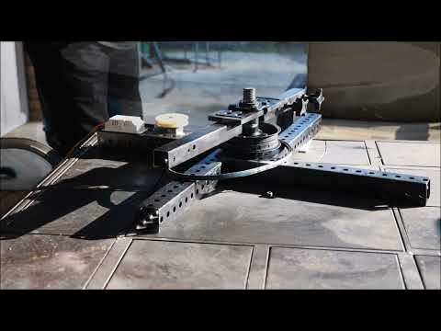
https://sites.google.com/view/360photoboothrentalmalibu/home
Notes:
https://drive.google.com/drive/folders/1LuDTqxKkMH9nX-0_wIvFUxoCZJGftF2I?usp=sharing
https://docs.google.com/document/d/1ZRMKUZ7_74-ZbMVzujIos8oVJBHV0DDBv9McTVMMHTs/edit?usp=sharing
https://docs.google.com/document/d/1ZRMKUZ7_74-ZbMVzujIos8oVJBHV0DDBv9McTVMMHTs/pub
https://docs.google.com/document/d/1ZRMKUZ7_74-ZbMVzujIos8oVJBHV0DDBv9McTVMMHTs/view
https://docs.google.com/presentation/d/1GdMkcIuq3MNuFaFkSuLp9vZpVP3rm1QxMPTCm5f4nFg/edit?usp=sharing
https://docs.google.com/presentation/d/1GdMkcIuq3MNuFaFkSuLp9vZpVP3rm1QxMPTCm5f4nFg/pub
https://docs.google.com/presentation/d/1GdMkcIuq3MNuFaFkSuLp9vZpVP3rm1QxMPTCm5f4nFg/view
https://docs.google.com/document/d/1xBl2cu3aw6djX5bmM2kUXXwA6_yokVuAlUbdwcpf7sU/edit?usp=sharing
https://docs.google.com/document/d/1xBl2cu3aw6djX5bmM2kUXXwA6_yokVuAlUbdwcpf7sU/pub
https://docs.google.com/document/d/1xBl2cu3aw6djX5bmM2kUXXwA6_yokVuAlUbdwcpf7sU/view
https://docs.google.com/presentation/d/1u01K0CWmIYRAC5nHs-FJF7O4hIV1gTHRO3vJQsJn9Ow/edit?usp=sharing
https://docs.google.com/presentation/d/1u01K0CWmIYRAC5nHs-FJF7O4hIV1gTHRO3vJQsJn9Ow/pub
https://docs.google.com/presentation/d/1u01K0CWmIYRAC5nHs-FJF7O4hIV1gTHRO3vJQsJn9Ow/view

Slide 26
what is a 360 video booth
https://sites.google.com/view/360photoboothrentalmalibu/home
Notes:
360 video booth automatic,what is a 360 video booth,360 video booth business,360 video booth cost,360 degree photo booth video,360 experience video booth,360 video booth for rent,360 grad video booth,360 video booth hire,360 video booth with ring light,orcavue life 360 video booth,360 video booth near me,revolve 360 video booth near me,360 slow motion video booth,orcavue 360 video booth,orcavue xl 360 video booth,360 video booth platform,360 video booth platform spinner

